Slide 1
How do annual members and casual riders use Cyclistic bikes differently?
An analysis prepared by Jacob Ko
Notes:
In 2016, Cyclistic launched a bike-share offering. The program now have 5,824 bicycles that are geo-tracked and locked into a network of 692 stations across Chicago. The bikes can be unlocked from one station and returned to any other station in the system anytime.

Slide 2

A key to future growth for Cyclistic!
Cyclistic's finance analysts have concluded recently that annual members are much more profitable than casual riders.
Therefore, maximizing the number of the annual members will be key to future growth!
Notes:
Customers of Cyclistic who purchase single-ride or full-day passes are referred to as casual riders and those who purchase annual memberships are Cyclistic members. Cyclistic's finance analysts have concluded recently that annual members are much more profitable than casual riders. Therefore, maximizing the number of the annual members will be key to future growth.

Slide 3
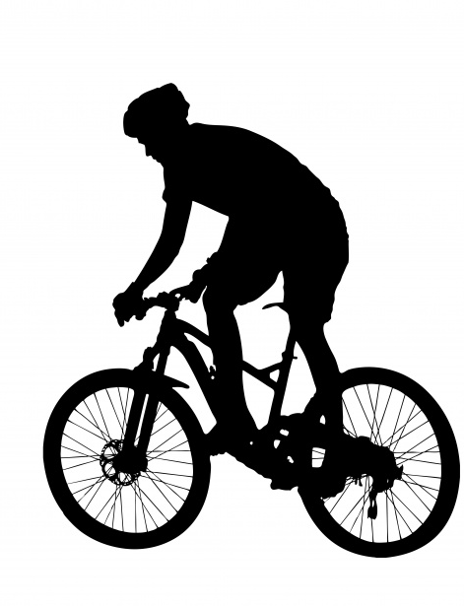
Casual riders are potential members!
There is a very good chance to convert casual riders into members because they are already aware of the Cyclistic program and have chosen Cyclistic for their mobility needs!
Notes:
Until now, Cyclistic's marketing strategy relied on building general awareness and appealing to broad consumer segments. However, rather than creating a marketing campaign that targets all-new customers, there is a very good chance to convert casual riders into members because casual riders are already aware of the Cyclistic program and have chosen Cyclistic for their mobility needs.

Slide 4
Understanding the nature of casual riders

Slide 5
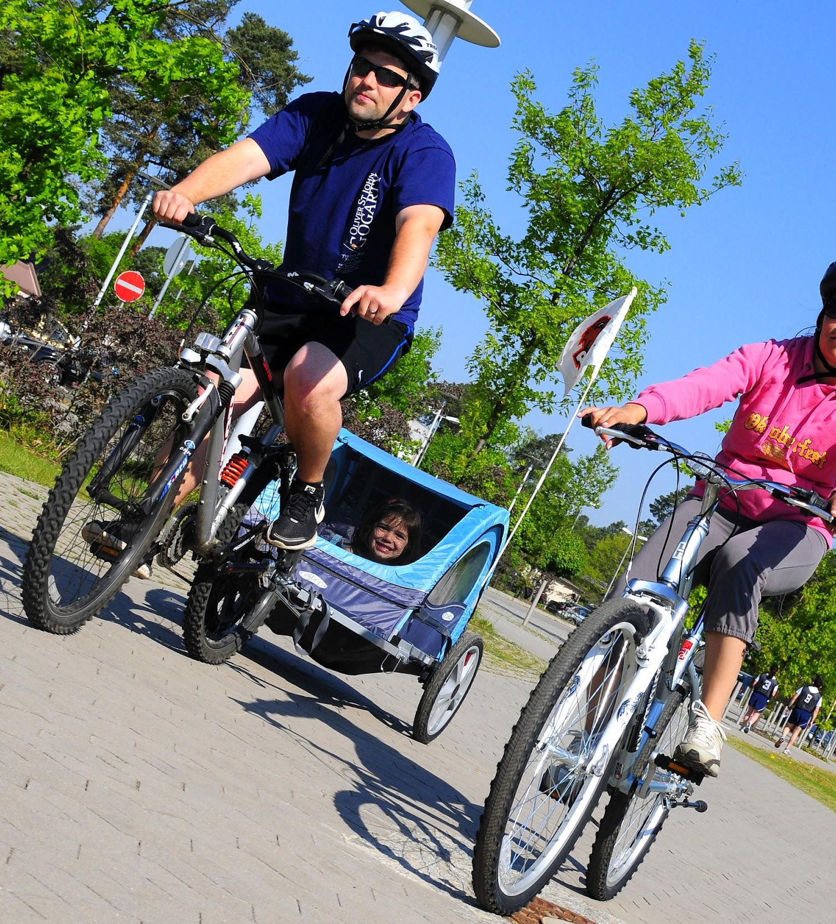
Casual riders enjoy longer bike trip than annual members

Slide 6
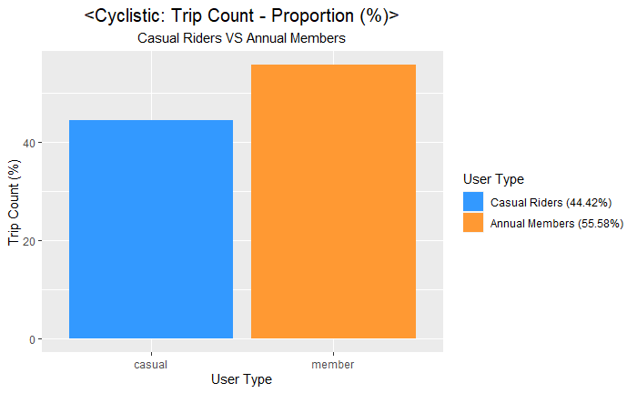
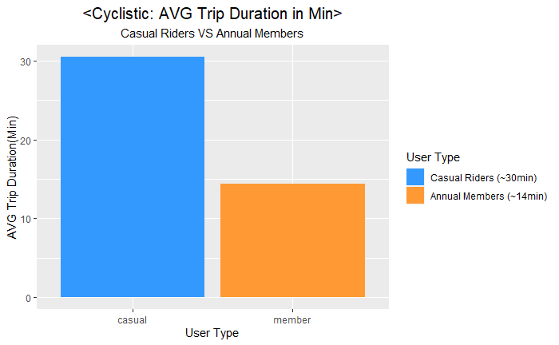
Casual riders enjoy longer bike trips
Notes:
Analysis: Casual riders make up 62.83% of the total trip duration and ride for about 30 min per ride. However, the actual trip count is only 44.42% from the total trip count which is less than the trip count of annual members.

Slide 7
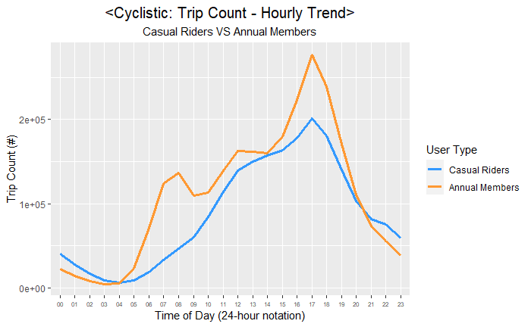
Annual members ride to commute
Notes:
Analysis: Annual members tend to have short trips with less than 15min per ride between 6am and 9am, 11am and 1pm, 4pm and 6pm which may indicate they ride, not for leisure, but to commute. However, casual riders mostly ride in the afternoon, probably with family or friends, on sunny days.

Slide 8
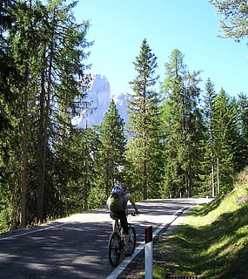
Majority of casual riders ride on the weekends

Slide 9
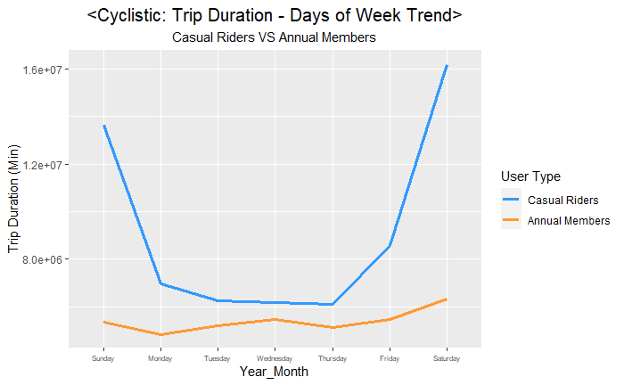
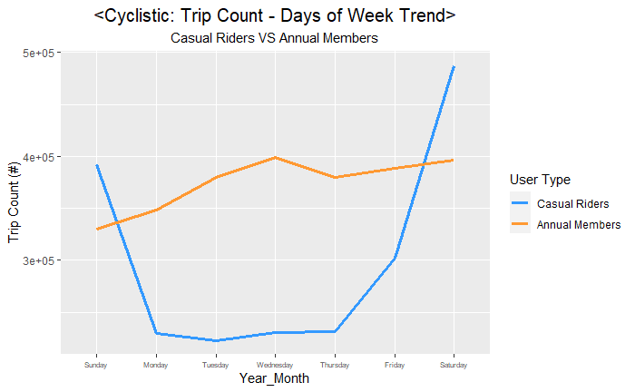
Majority of casual riders ride on the weekends
Notes:
Analysis: The majority of casual riders on the weekend. However, annual members consistently maintain trip duration and trip count throughout the week. This factor confirms again that casual riders ride for leisure but annual member ride to commute.

Slide 10
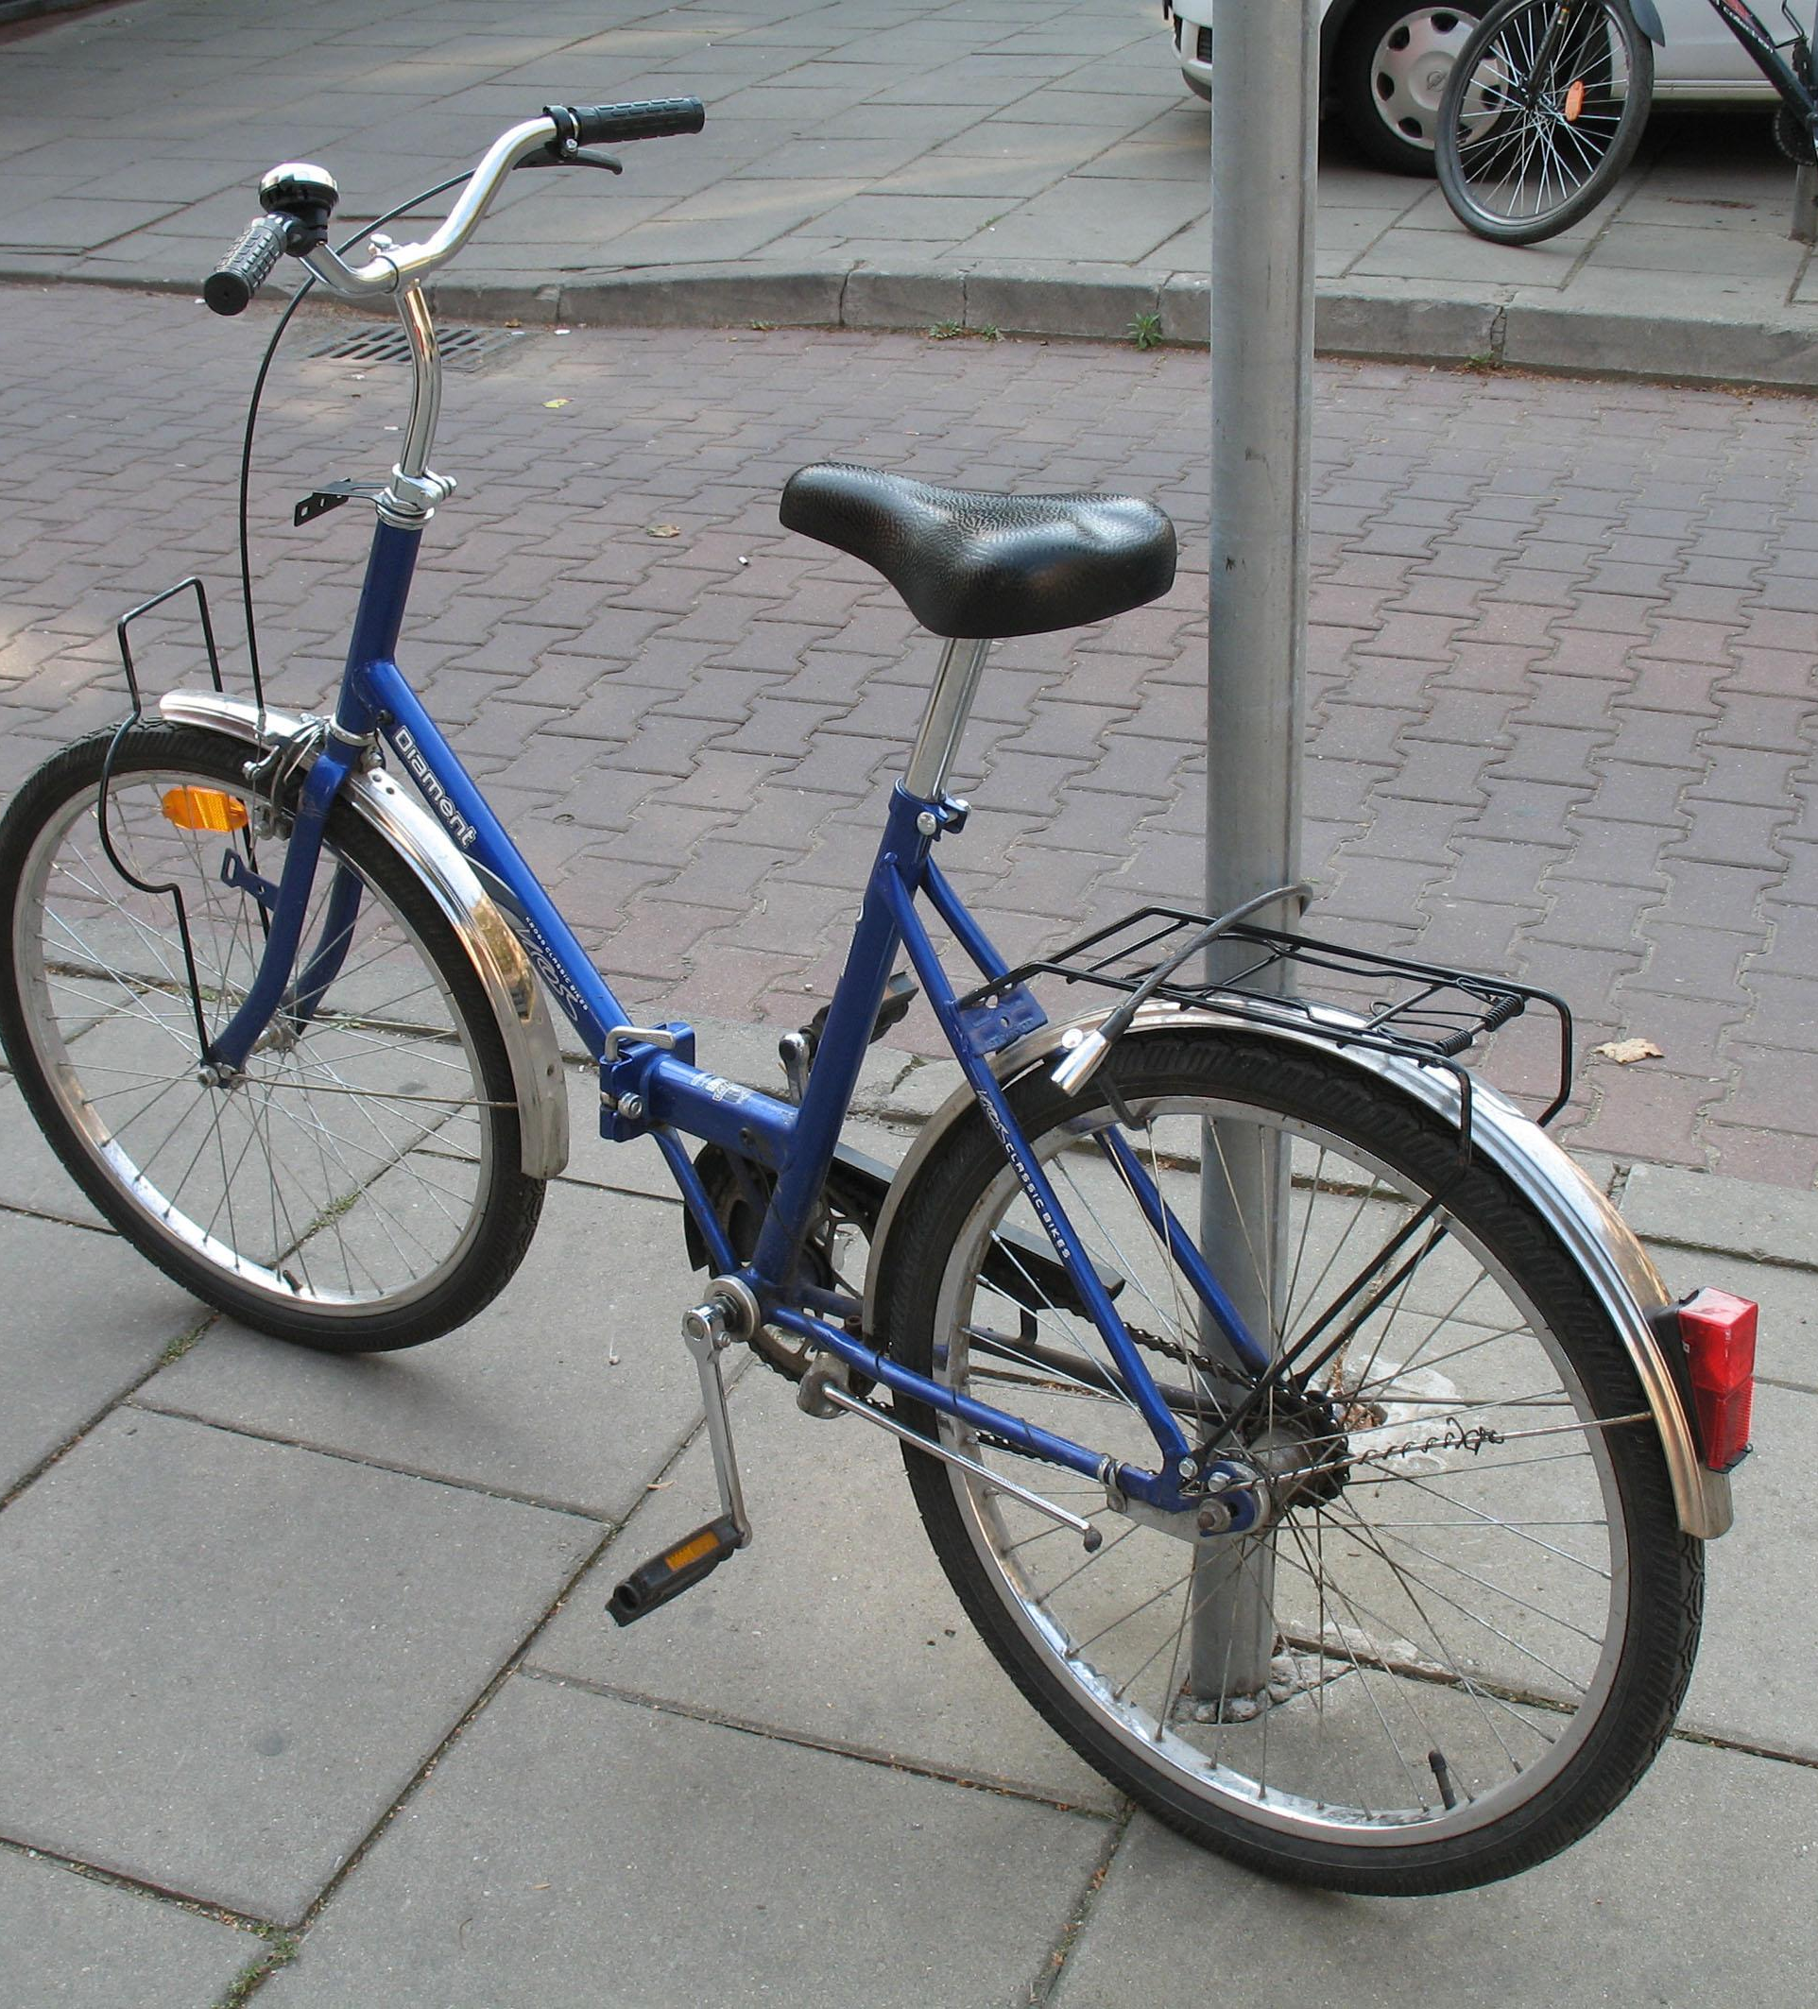
Classic bike is casual riders’ favorite bike type

Slide 11
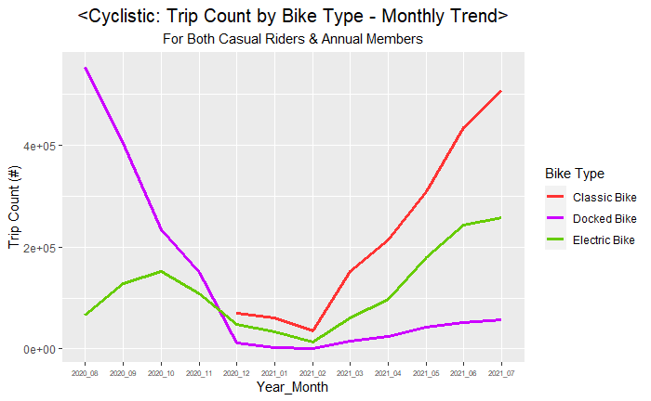
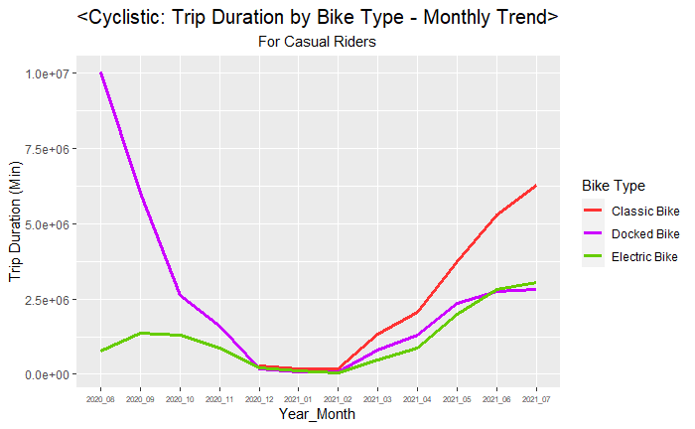
Classic bike is casual riders’ favorite bike type
Notes:
Analysis: Both casual riders and annual riders enjoy riding classic bike. At first, casual riders favored docked bikes. However, ever since Cyclistic introduce classic bike, many of casual riders switched over to classic bike. Now, they favor classic bike the most!

Slide 12
Top 3 recommendation to help convert casual riders into annual members

Slide 13
Top 3 recommendations
Targeting average trip duration - 30 min per ride
Targeting weekend riders - with family and friends
Targeting favorite bike type - classic bike
Notes:
Recommendation 1: Targeting average trip duration for casual riders
Casual riders make up 62.83% of the total trip duration and ride for about 30min per ride. Therefore, if there is an annual membership features that will benefit leisure riders who ride over 30 minutes per ride surely will appeal many of casual riders to get the membership.
Recommendation 2: Targeting weekend casual riders
Casual riders tend to ride bike in the afternoon on the weekend, most likely with family and friends. Therefore, if there is an annual membership features that will benefit leisure riders who ride on the weekends with family and friends surely will appeal many of casual riders to get the membership.
Recommendation 3: Targeting favorite bike type for casual riders
Casual riders favor classic bike. Therefore, if there is an annual membership features that will benefit leisure riders who enjoy riding classic bikes surely will appeal many of the casual riders to get the membership.

Slide 14
The best time to start the marketing campaign

Slide 15
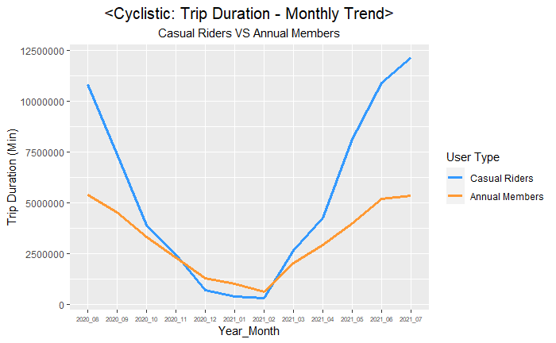
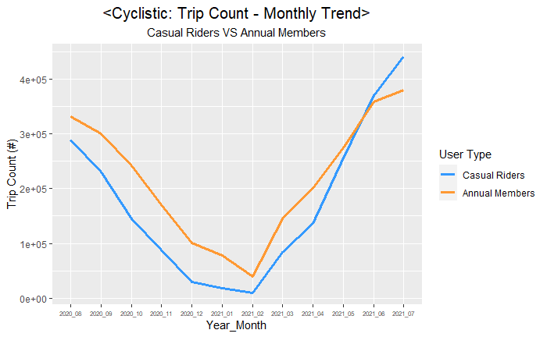
Preseason and On-season
Notes:
Analysis: The bike usage of both casual riders and annual members start to decline noticeably in October and hit the lowest in December. In February, the usage started to pick up and noticeably picks up in April and reach its peak in July.

Slide 16
Conclusive insight

Slide 17
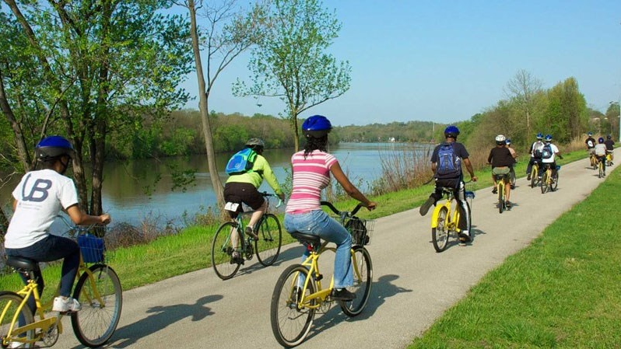
Casual riders are leisure bike riders!
Notes:
Casual riders are leisure bike riders. They enjoy riding bike with family and friends in the afternoon on the weekend, most likely on the sunny day. Contrast to casual riders, annual members ride to commute to work or to school. Current annual membership features probably appealed them because there are merit in frequent bike usage.
If additional features that will benefit those casual riders who ride for leisure be added to the membership, many more casual riders will get membership.
And the trip duration and trip count on the weekends, because of this new additional features into the membership, will surely be increased drastically by annual members who have converted over from casual riders!

Slide 18
Thank you!

